Slide 1
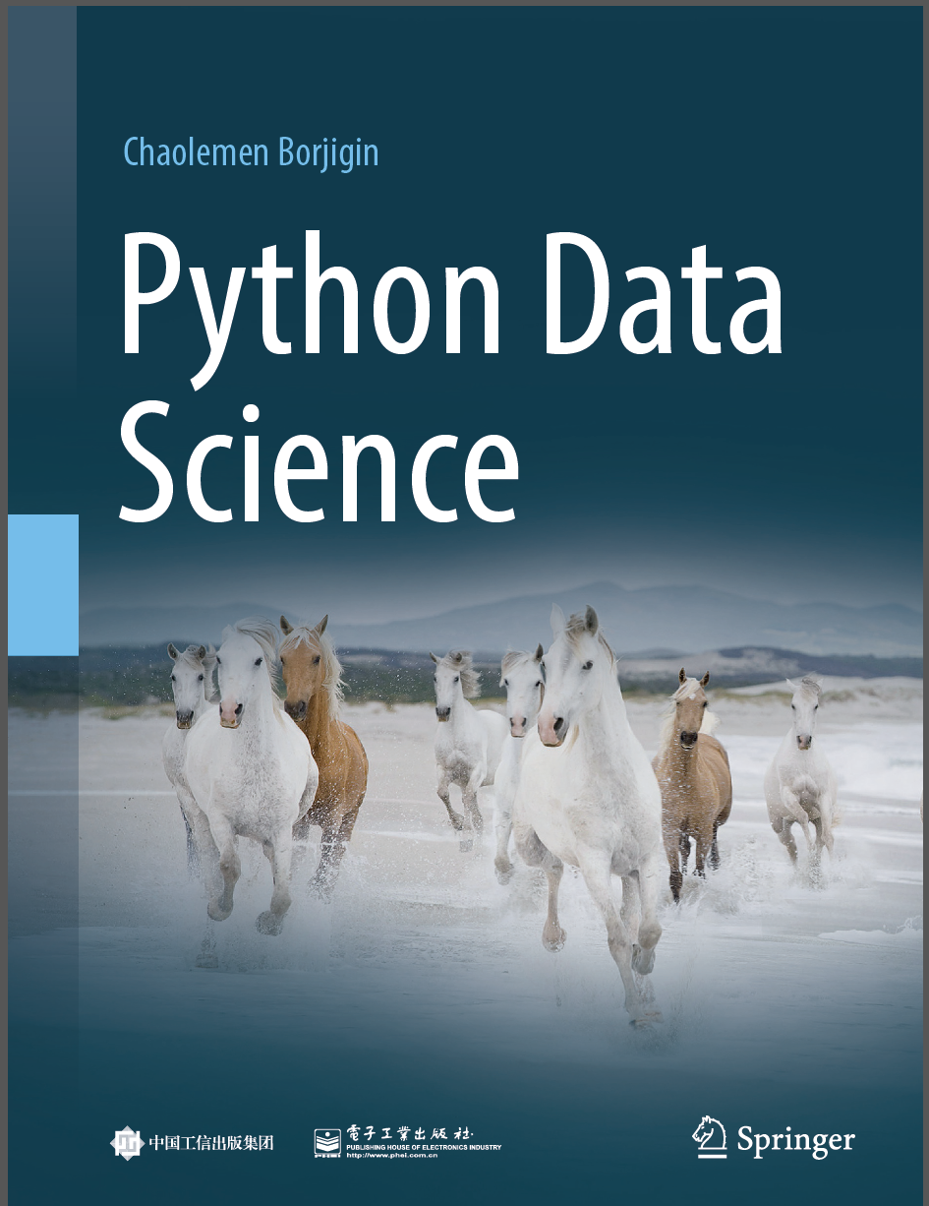
Python Data Science
Chaolemen Borjigin
Renmin University of China
chaolemen@ruc.edu.cn

Slide 2
1.1 How to learn Python for data science
▼ Chapter 1 Python and Data Science
► 1.1 How to learn Python for data science
Chaolemen Borjigin
Renmin University of China
chaolemen@ruc.edu.cn

Slide 3
Summary of this chapter
▼ Chapter 1 Python and Data Science
► 1.1 How to learn Python for data science
1.1.1 What are the advantages of Python?
1.1.2 Why do I need to learn Python?
1.1.3 What should I learn about Python?

Slide 4
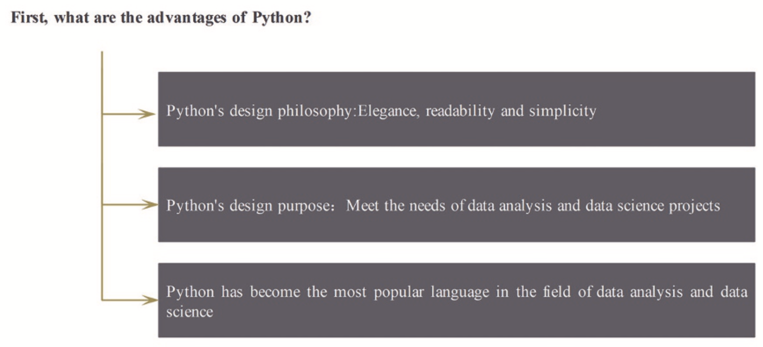
1.1.1 What are the advantages of Python?
▼ Chapter 1 Python and Data Science
► 1.1 How to learn Python for data science

Slide 5
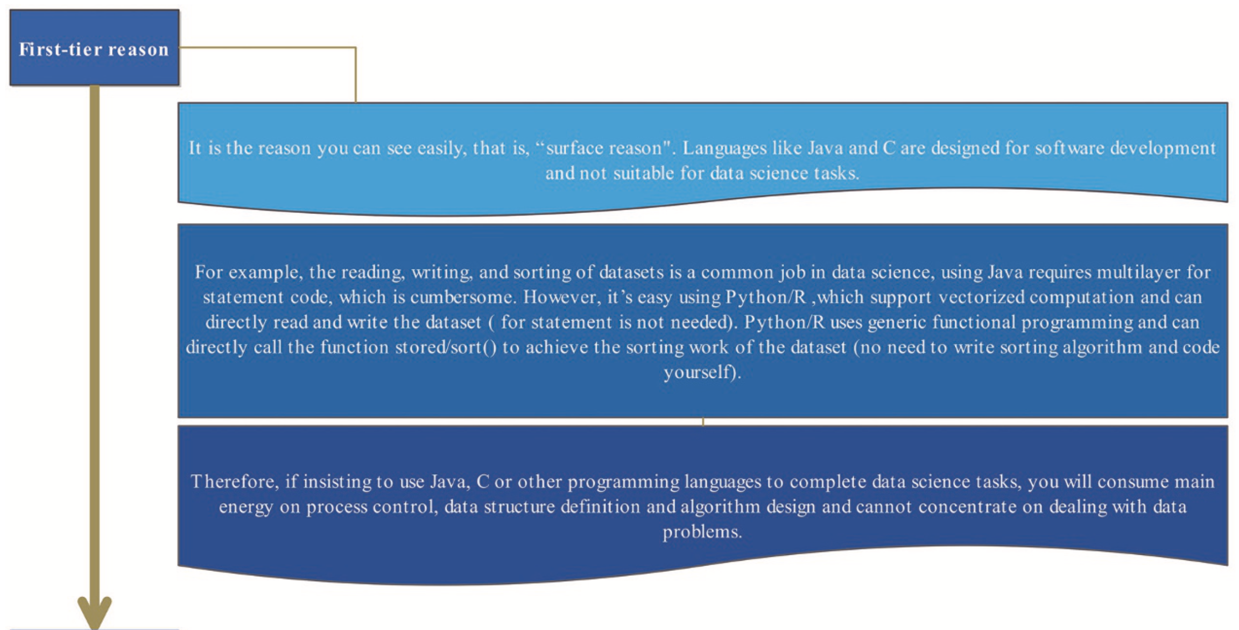
1.1.2 Why do I need to learn Python?
▼ Chapter 1 Python and Data Science
► 1.1 How to learn Python for data science
Figure 1.1 Three reasons to learn Python (part 1)

Slide 6
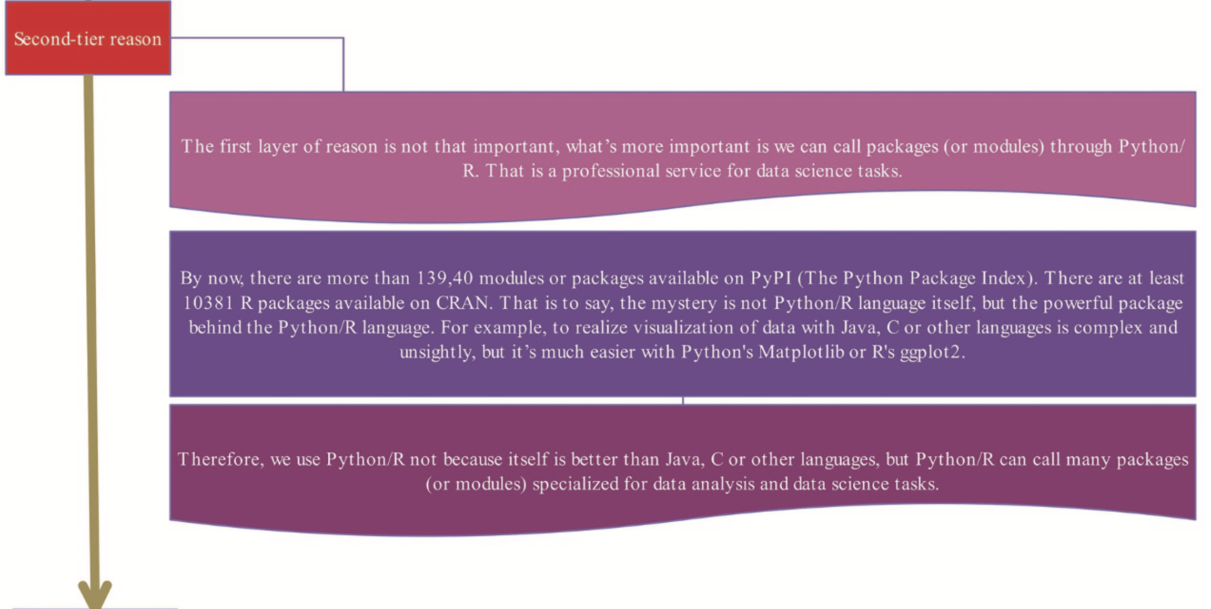
1.1.2 Why do I need to learn Python?
▼ Chapter 1 Python and Data Science
► 1.1 How to learn Python for data science
Figure 1.1 Three reasons to learn Python (part 2)

Slide 7
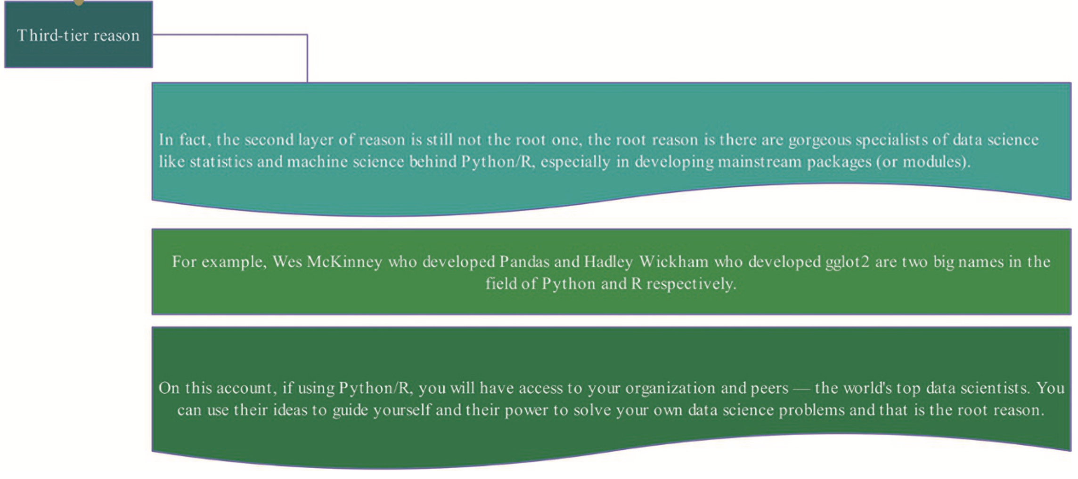
1.1.2 Why do I need to learn Python?
▼ Chapter 1 Python and Data Science
► 1.1 How to learn Python for data science
Figure 1.1 Three reasons to learn Python (part 3)

Slide 8
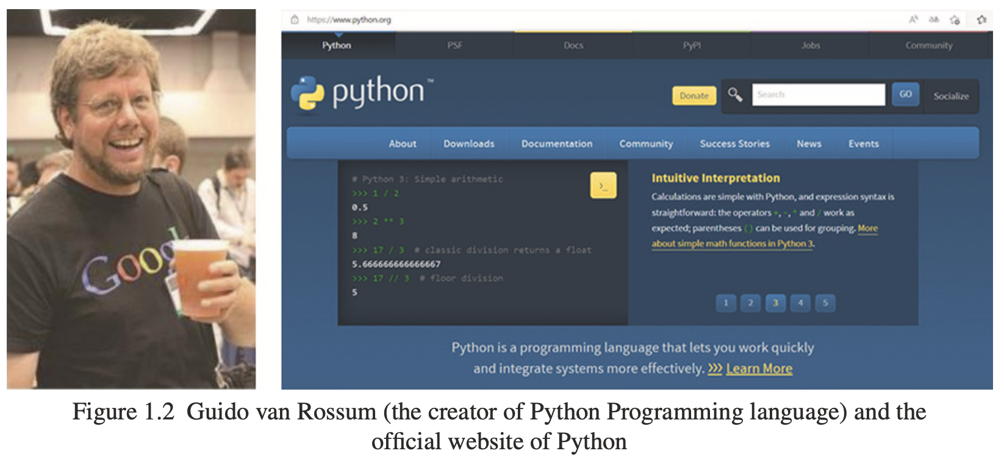
1.1.2 Why do I need to learn Python?
▼ Chapter 1 Python and Data Science
► 1.1 How to learn Python for data science

Slide 9
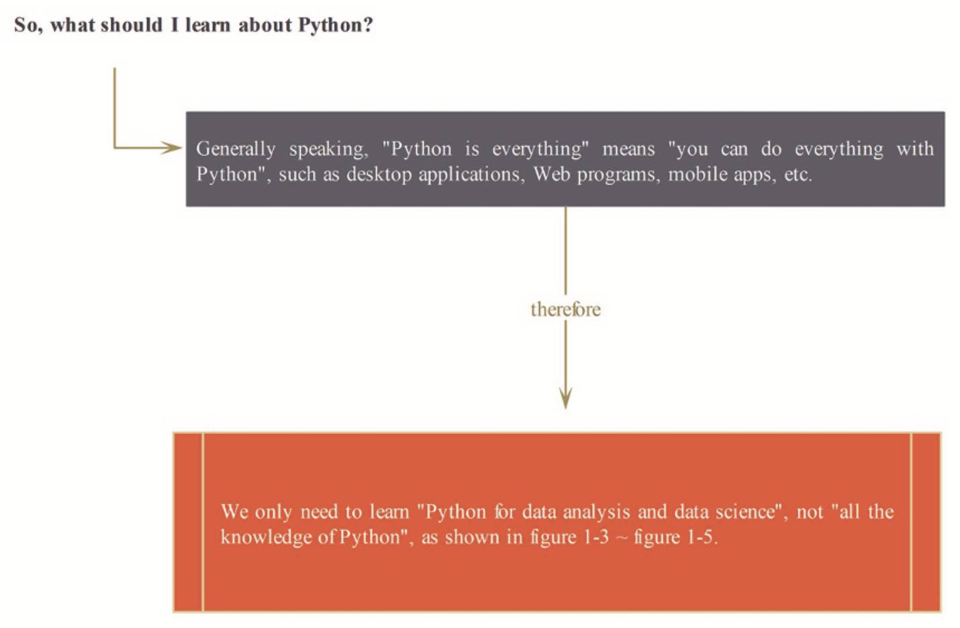
1.1.3 What should I learn about Python?
▼ Chapter 1 Python and Data Science
► 1.1 How to learn Python for data science

Slide 10


